Slide 1


Quit with Us: A social marketing intervention to motivate and assist individuals to stop smoking using Tenovus retail outlets.
Maura Matthews and Dr Sioned Pearce
UK National Smoking Cessation Conference
13th June 2014

Slide 2

Who are we and what do we do?
Tenovus is Wales’ biggest cancer charity.
Our aims are simple: to help prevent, treat and find a cure for cancer.
As part of this we offer support, advice and treatment for cancer patients, information on cancer prevention and funding for research to improve the outcomes for people with cancer.
We do this where it is needed most – right at the heart of the community.

Slide 3
Why we did it?
The Quit with Us intervention was designed to gauge:
the effectiveness of community charity shops in providing brief intervention for smoking cessation;
asses knowledge and behaviour among customers;
raise awareness of the health risks associated with smoking.

Slide 4

Welsh Context
Lung cancer remains a major health problem in Wales, it is the most common cancer affecting both men and women.
21% of the Welsh Population currently Smoke (Welsh Health Survey, 2013).
Mortality rates remain disappointingly high, with the poorest survival rates found within areas with the highest indices of social deprivation.
There is an increase in the incidence in women, reflecting the changes in the prevalence of tobacco smoking within the population (Welsh Cancer Intelligence and Surveillance Unit, 2011).

Slide 5
Background
Largest single preventable course of ill health and premature death in Wales, causing 5,650 deaths per year.
Leading cause of health inequalities.
Significant burden on the NHS, 20% of all hospital admissions (Tobacco Control Action Plan, 2012).
Cost to the NHS £386 million (Tobacco Control Action Plan, 2012), 7% of total health care expenditure in Wales.
34 million working days lost as a result of smoking related disease in England and Wales (Parrott & Godfrey, 2004)

Slide 6
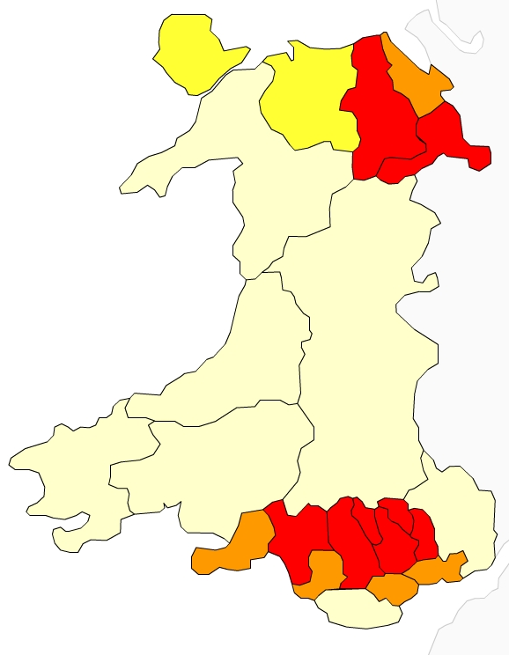
Historical Context
Lung Cancer Incidence
Deprivation
Significantly High
High
Low
Significantly Low

Slide 7
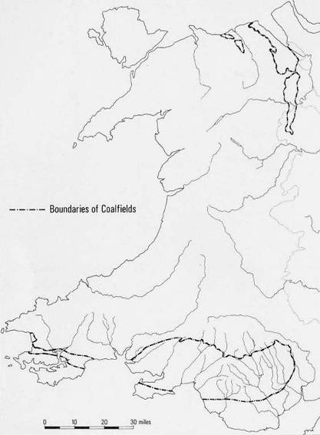
Lung Cancer Incidence
Coal Fields of Wales

Slide 8

Why use Charity Shops?
They are accessible, on every high street in key locations.
They receive thousands of visits a year (90,000 transactions annually).
Research shows that members of the public identify with charity shops more than other retail outlets because of the cause they support, affordability and vested interest through stock (Horne & Maddrell, 2004)
Many Tenovus shops are located in deprived areas. (27% in the first 300 LSOA, WIMD, 18% in the first 100).
Previous successful campaigns delivered through this mechanism such as the Here Comes the Sun Campaign. (76% respondents felt comfortable asking for health advice in a Tenovus shop).
Notes:
Average over 1500 transaction each month per region, 5 regions = 90,000

Slide 9
Research Methods
45 Welsh Tenovus charity shops were offered to participate in the campaign.
Brief intervention for smoking cessation training was offered to all 45 shop mangers provided by Public Health Wales.
32 shops were provided with a toolkit containing Welsh Government quit pack, quiz/survey, promotional materials, posters, window tags.
10 shops within close proximity to level 3 pharmacy smoking cessation services were given Tenovus referral cards.
Notes:
https://statswales.wales.gov.uk/Catalogue/Community-Safety-and-Social-Inclusion/Welsh-Index-of-Multiple-Deprivation/WIMD-2011/WIMD2011

Slide 10
Research Methods
Data collection through record of brief interventions carried out and quiz survey delivered in the shop.
Quantitative data inputting and analysis of quiz and customer feedback.
The Quit with Us campaign was launched on No Smoking Day 2014.
We also asked Stop Smoking Wales to record any referrals that came to them from the Quit with Us campaign to track outcomes.
Notes:
https://statswales.wales.gov.uk/Catalogue/Community-Safety-and-Social-Inclusion/Welsh-Index-of-Multiple-Deprivation/WIMD-2011/WIMD2011

Slide 11
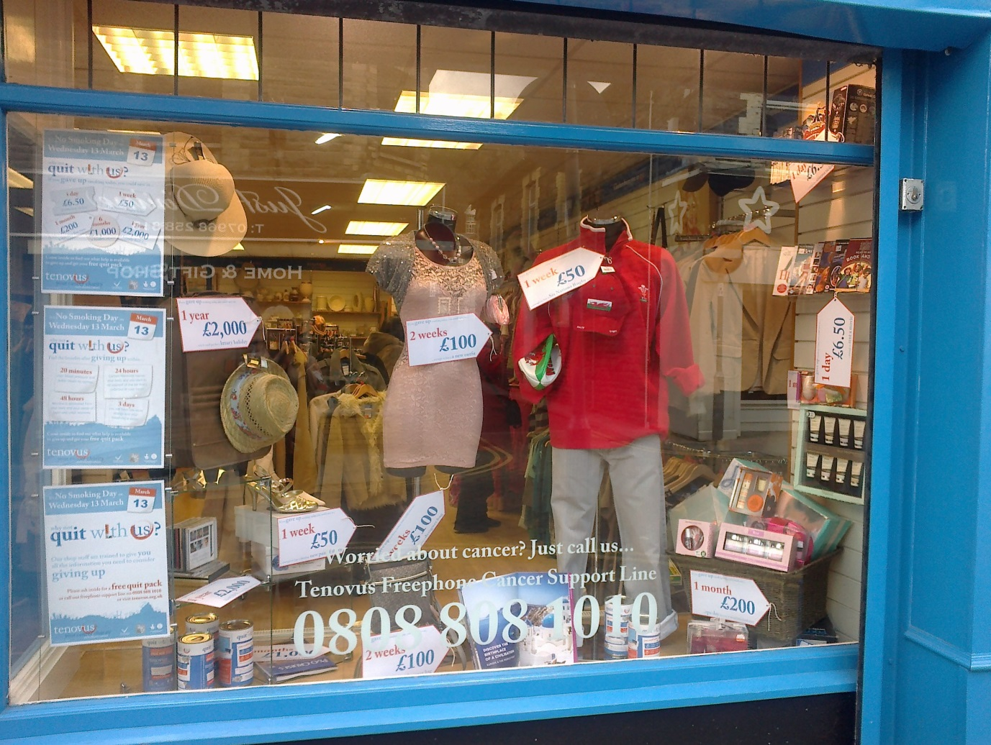


Slide 12
Results
38 Tenovus shop staff were trained in brief intervention for smoking cessation between February and March 2014.
32 shops ran the intervention for one month.
156 stop smoking conversations recorded.
38 conversation were with current smokers.
40 conversations with ex-smokers.

Slide 14
Findings: knowledge
13% knew the true cost of smoking 20 a day for a year was £2,372.
Only 4% knew that 90% of lung cancer in men is caused by smoking.
46% knew that there are 4,000 chemicals in one cigarette.
There was little difference in knowledge between smokers and non-smokers……

Slide 15
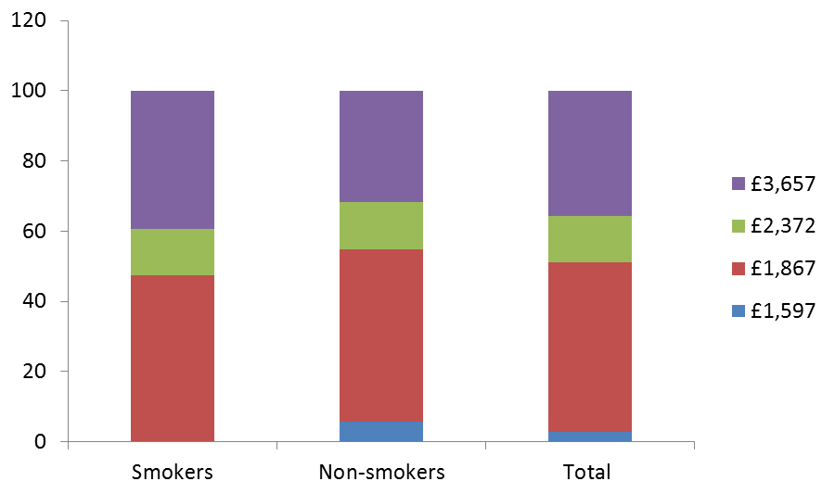
What is the cost of smoking 20 a day for 1 year?

Slide 17
Findings: knowledge
Only 20% knew that all of the following problems are caused by smoking:
Poor eyesight
Heart disease
Cervical cancer
Mouth cancer
Fertility problems
Wrinkles

Slide 18
What percentage of people in Wales smoke? (%)

Slide 19
How much does it cost every year to smoke 20 cigarettes a day? (%)

Slide 20
What percentage of lung cancer is due to smoking? (%)

Slide 21
How many chemicals are there in one cigarette? (%)

Slide 22
How long does it take for nicotine to leave your body when you stop smoking? (%)

Slide 23
Is there an increased risk of developing cancer if you smoke and drink alcohol at the same time? (%)

Slide 24
Findings: behaviour
38 smokers and 104 non-smokers took part (14 did not answer).
Of the 38 smokers who took part 32% smoke 16-20 cigarettes a day and over half had tried to quit at one point in their lives:
  8 using e-cigarettes
  16 using nicotine replacement therapy
  3 using will power.
The total number of cigarettes smoked per day was approximately 658 (average of 17 per day).

Slide 25

Findings: behaviour
Those who smoked from 5 to 15 cigarettes a day averaged 15 years as a smoker.
Those who smoked between 16 and 30 a day averaged 31 years as a smoker.
This shows a possible link between amount of time a person has smoked and a higher number of cigarettes per day.

Slide 26
Findings: behaviour
40 (26%) of the 156 were ex-smokers and the time since their last cigarette ranged from 1 day to 50 years.
Smokers who had tried to quit had smoked slightly longer but smoked slightly less on average than those who had never tried to quit.

Slide 27
Findings: feedback

Slide 28
Findings: feedback

Slide 29
Conclusions
Knowledge: mixed with the most significant lack of knowledge on the percentage of lung cancers in men caused by smoking.
Behaviour: there were some links between behaviour and knowledge, but little difference between smokers and non-smokers on this.
Intervention: feedback for the intervention was positive and 39% felt they had improved knowledge, however further exploration is needed around the large percentage who felt their knowledge had stayed the same.
Notes:
%8% of respondents rated the level of information provided as ‘excellent’, 21% as ‘very good’ and 18% as good. No one rated the training as ‘poor or ‘average’.
%8% of respondents rated the level of information provided as ‘excellent’, 21% as ‘very good’ and 18% as good. No one rated the training as ‘poor or ‘average’.

Slide 30
Future Research
Further analysis of the data relation to intention to quit.
Follow-up phone calls to smokers to test knowledge of smoking cessation techniques among smokers and any intention or action on quitting.
Focus more on smokers as this group yielded the most interesting results with most scope for development.
Extend the project to all 65 Tenovus shops.
Develop partnership with other smoking cessation organisations.

Slide 31
Any Questions?
Maura Matthews
Health and Wellbeing Development Manager
Maura.matthews@tenovus.org.uk
Direct Line: 02920768871
Dr Sioned Pearce
Research Officer
Sioned.pearce@tenovus.org.uk
Direct Line: 02920768874

Slide 32
Thank you for listening

