Slide 1
Engaging With Pregnant Smokers..... A Creative Arts Social Marketing Project
Yvonne Hermon
Smoking & Pregnancy Coordinator
Dudley Stop Smoking Service

Slide 2
Dudley Stop Smoking & Pregnancy Service
Well established service since 2000
Our quit rate was good - 56%
In 2011/12 we received 796 referrals
however, only:
43% (n346) accepted a F2F contact
265 pregnant smokers set a quit date
149 went on to successfully quit (measured at 4 weeks)
SATOD – 16.2%
Notes:
We are seen as a good service across the West Midlands and have probably been the most consistent

Slide 3
Aim
‘Our challenge was to engage, involve and create a range of ways to enable us all to really understand pregnant smokers. Then develop a concept or brand to be used to encourage behaviour change’

Slide 4
So we wanted to find out...
Why do women continue to smoke in pregnancy?
Does anyone influence her decision to smoke either by helping or hindering
Is there anything that would help her to stop smoking?
Where do they go for good advice? Who do they listen to and who do they trust?
Notes:
Talk about commissioning Creative Health – previous experience in arts and health Kick Ash

Slide 5
Steering Group Team
Buy in was crucial – our team were picked:
Midwifery Managers to service user
Their knowledge and expertise was vital
It kept us grounded with realistic outcomes
Artists and health professionals worked side by side
The project was born....!
Notes:
Partnership working was crucial and proven so.
Explain why we chose the title bloomin’

Slide 6
So what did we actually do?....

Slide 7
How did we involve comedy, craft and going to social clubs to engage with women?
Notes:
KIM TO COME IN... Arrr.... I woz in the audience! She woz really funny she told this story......

Slide 8
We held workshops at a hostel for teenage mothers
Notes:
So we moved onto the hostel where we used a visual artist to create pictures for their communal lounge and notice boards for their own flats.

Slide 9
We spoke to women in antenatal clinics offering a hand massage

Slide 10
What did we find out?
AND
What did we do about it?

Slide 11
They want to be told the risks
Women found current information too clinical and far removed from their everyday life
“ When I was in labour I kept going out for fags because I was so stressed... Then the baby’s heart rate dropped really low and there was a panic, and I couldn’t have a water birth which I was really gutted about”...
Notes:
Kim to come in here and say.... “When I was in labour....
The nurses kept telling me not to but they didn’t tell me why. Then the baby’s heart rate dropped really low and there was a panic, and I couldn’t have a water birth which I was really gutted about. I’ve been told since that all that could have happened because I smoked, but nobody told me while it was happening, they just told me to stop.”

Slide 12
Women felt that the smokefree message was not delivered strongly enough....
“They give you all these leaflets and you don’t know what to look at first. Personally I threw them all in the bin because I thought if they couldn’t be bothered to tell me what to do and what not to do then I couldn’t be bothered to read their leaflets.”
Notes:
KIM TO SAY.... “in antenatal and becomes diluted amongst other medical messages related to being pregnant”

Slide 13
Women felt midwives didn’t always understand their addiction
“It’s all very well them telling me I should
quit smoking but they don’t understand what
it’s like. I’m addicted to cigarettes, like a drug,
and it’s not easy to give up like they think it
is. They don’t know me, or my life.”
They wanted to be told it how it is – they wanted real stories
Notes:
KIM TO SAY “Its all very well them telling me I should....

Slide 14
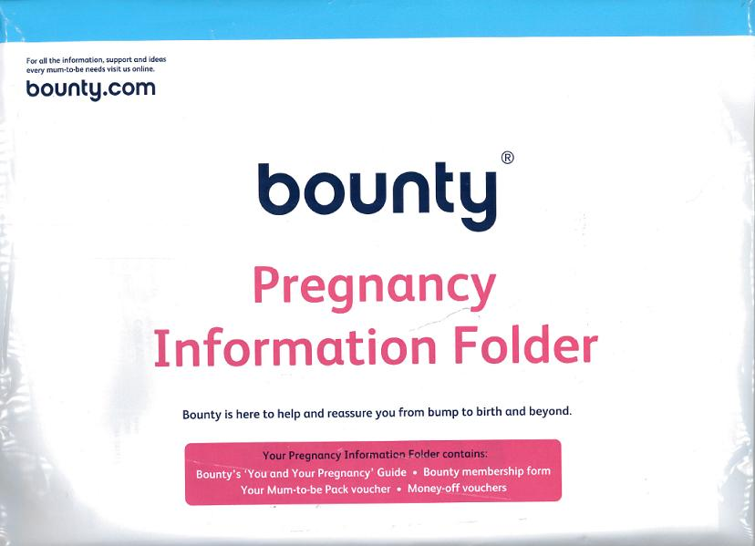
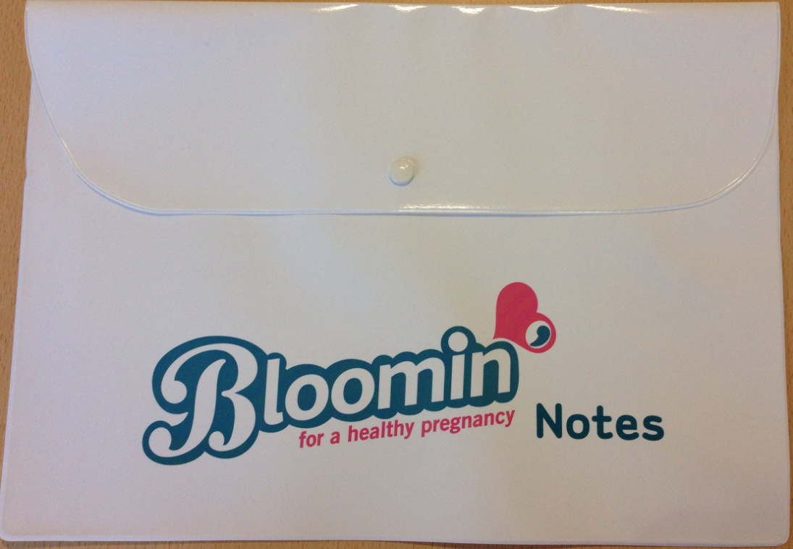
So what did we do about it?
Notes:
Changed practice.... We had agreement with the maternity managers to stop giving out the bounty packs at first contact. (they do get it but much later in pregnancy)
Collected local women’s stories who had quit smoking and used real women in the magazine.

Slide 15
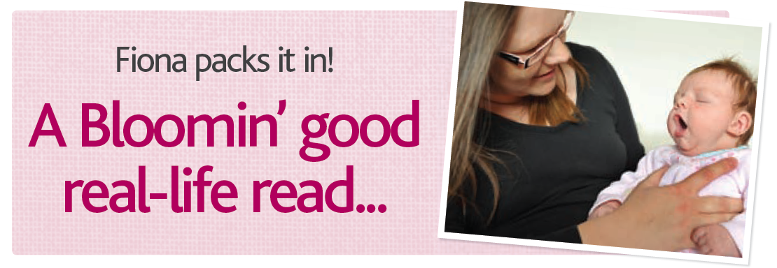
Real Life Stories
“It was some time after my little girl had been found to have a heart defect that I almost accidentally read it could have been caused by me smoking”.
Notes:
DONT READ, KIM to say this whilst looking at the magazine...

Slide 16
What else did we find out?

Slide 17
Families are a big influence
Women feel alone in their attempt to stop smoking whilst pregnant.
They are faced with mixed messages from partners and family (who smoke)
They are often encouraged to carry on smoking and being ‘taunted’ by smokers.
They felt more people needed to understand the effects of smoking in pregnancy.
Notes:
????? Is kim supposed to say this? It wasn’t a quote as such.

Slide 18
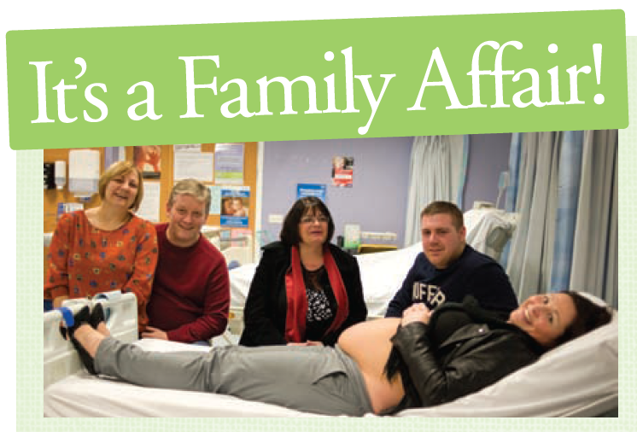
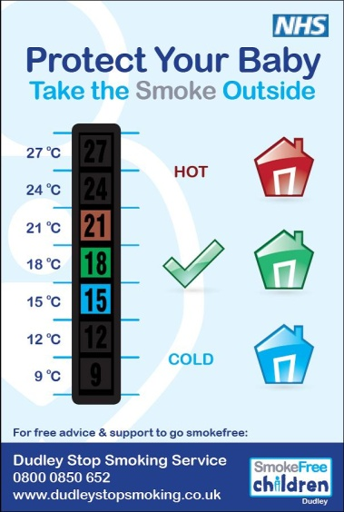
Spreading the Bloomin’ Word
Grandparents evening
Bloomin’ magazine
Safe Sleep Message
Notes:
DISPEL the MYTHS

Slide 19
Women smoke when they are bored and feel stressed and under pressure
“You get into habits when you smoke see,
like having a fag every time you have a cup of
tea or when a certain programme comes on
the telly, or when you’ve had a row – or just
when you really have nothing better to do.
Now I haven’t even thought about having a
fag while we’ve been making these pictures.
Weird isn’t it?”
Notes:
KIM

Slide 20
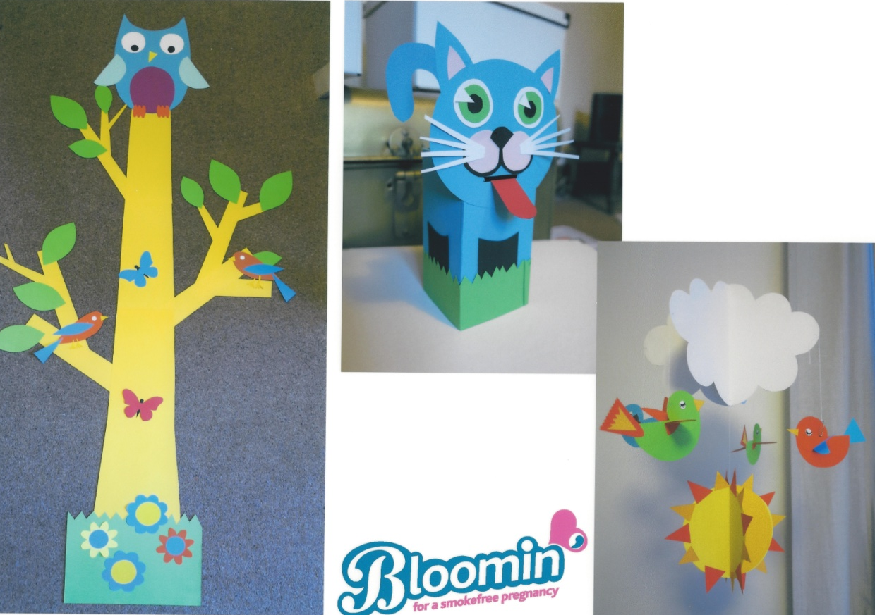
Developed some activities to alleviate their boredom
Exploring the idea of giving women something to do instead of smoking
Notes:
money box

Slide 21
In some cases women found it difficult to make the connection between smoking (and its negative effects) and their unborn baby.
“I actually wanted to smoke more when I was pregnant. I know it sounds cruel, but you only think about yourself when you’re as young as us because you don’t realise....”.
Notes:
KIM.... What you’re having, you don’t know what it’s going to look like or anything, and you don’t relate what’s going on inside you to producing another human being.”

Slide 22
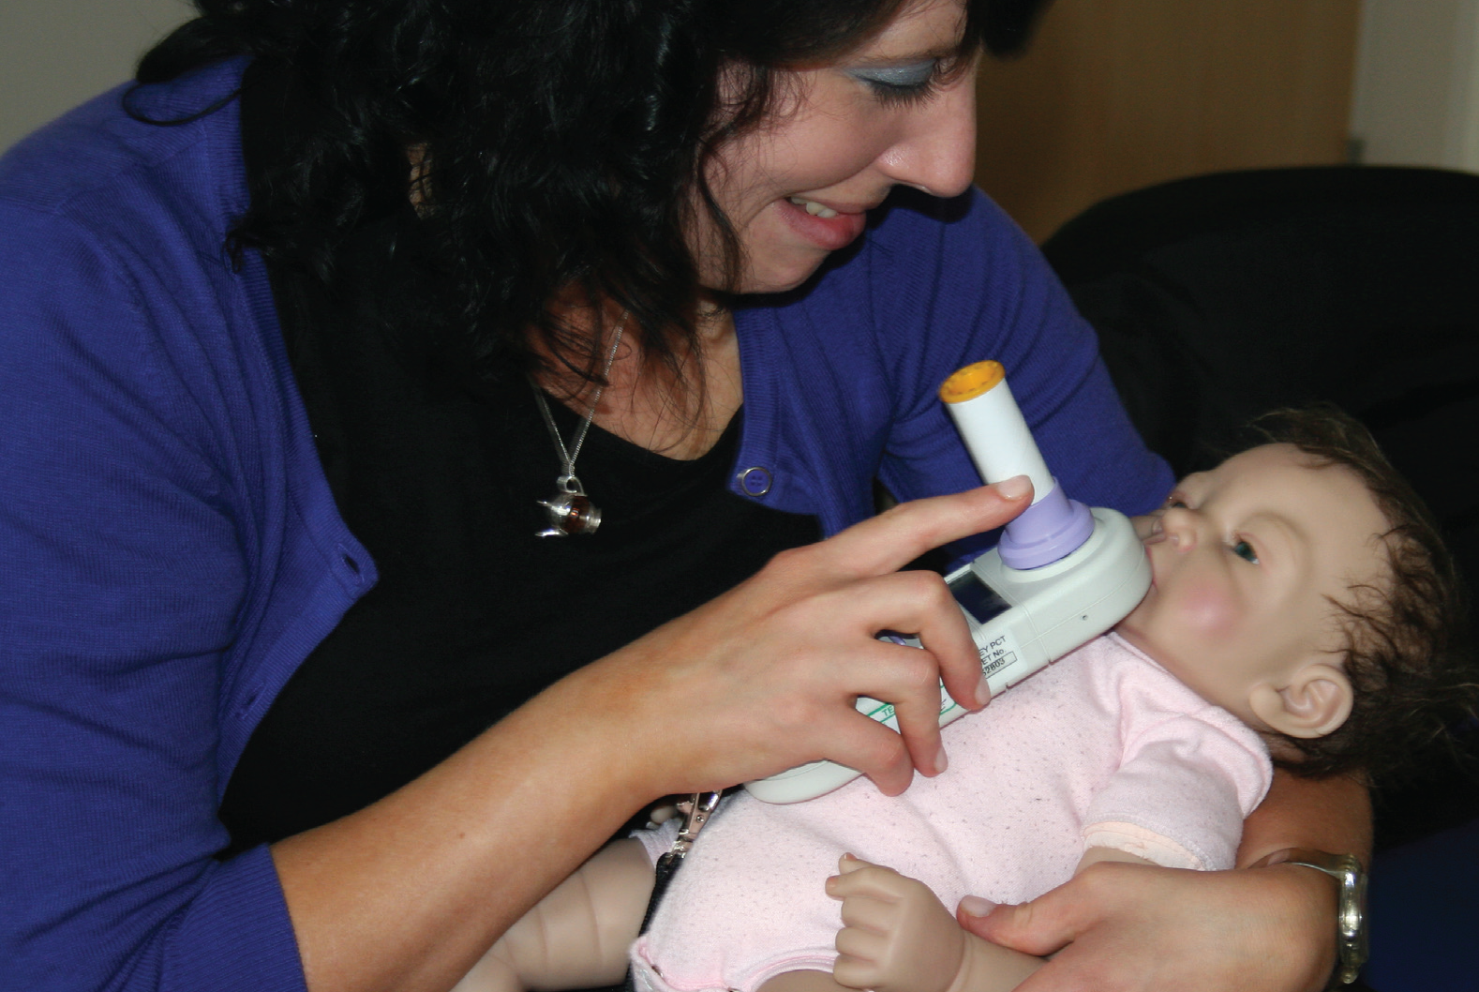
Strengthening the link
CO monitoring is now established as part of routine antenatal care – but using a ‘real life’ doll

Slide 23
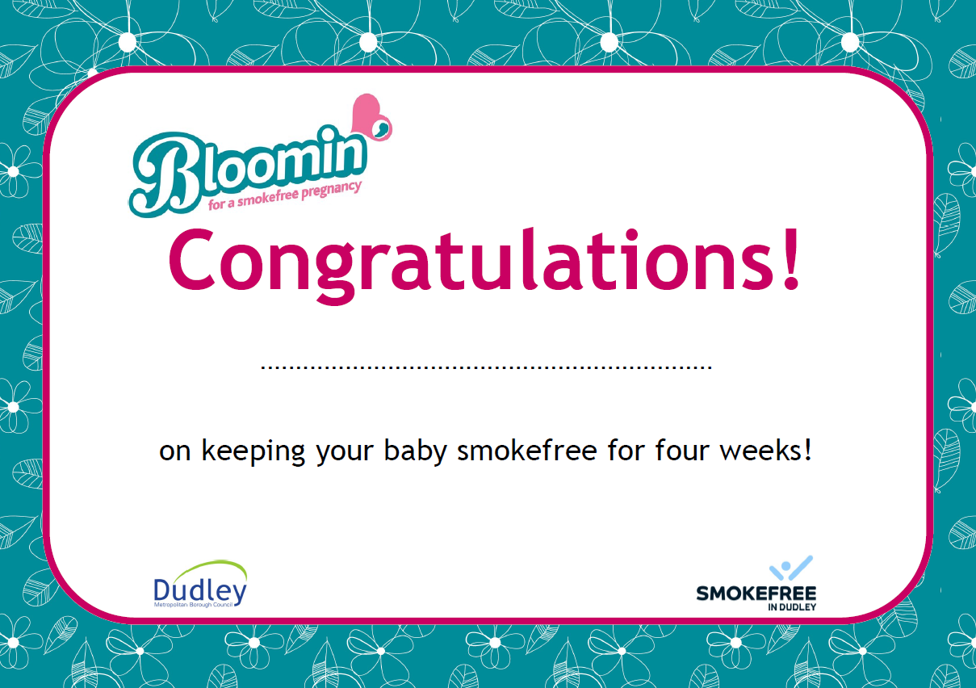
Women like being praised
“My midwife said ‘well done’, it made me feel like I was getting a pat on the back, and it felt great”
“You have to give up for yourself, not just the baby”
Notes:
KIM to say You have to have a goal, like going to a wedding helps you lose weight. And praise really helps me. When I was stopping smoking I went to the chemist’s every week to get patches. The woman there always said ‘well done’ if I’d gone all week without a fag. It made me feel like I was getting a pat on the head, and felt great.”

Slide 24
Ultimate achievement has been the change in practice
Raised the agenda of smoking & pregnancy
Women receive appropriate information
Midwives are listening & engaging with women
CO testing is well established
Bloomin’ has not only taken off its Blossoming....
Notes:
Introduce Kim at this point

Slide 25
