Slide 1
Smoke-free homes and cars
Dr Laura Jones
UKCTAS & University of Birmingham
13th June 2014

Slide 2
Outline
Part 1: Very brief advice on secondhand smoke training module and evaluation
Part 2: Legislative developments on banning smoking in private cars

Slide 3
Background
Healthcare professionals (and others who engage with families) are in a unique position to offer support to smoking families
Accept that SHS is harmful and believe that have a role to play
Able to raise the issue of SHS but lack knowledge and skills, as well as confidence, in providing practical support
Concern about damage to relationships
Richie et al. (2009, 2013); ASH Scotland, (2010); Jones et al. Unpublished data

Slide 4
The need for SHS training
A lack of training is the primary barrier to raising the issue of SHS
Confidence in raising the issue is higher for HCPs who have received formal training
“I feel I need a bit more training around it [raising the issue of SHS] because I'm only going on the basis of information that I’ve read and aware of and picked up in in-house briefings, but I’d like to attend training so I know exactly what I'm talking and discussing to parents” (SK64)
“Honestly speaking, I can’t remember ever receiving any formal training regarding smoking [and SHS]. Maybe a talk from a [local stop smoking service] advisor, but that, I’m just suggesting maybe. Most of my training came from learning from other midwives as part of being a student…” (AC245)
Richie et al. (2009); ASH Scotland, (2010); Jones et al. Unpublished data

Slide 5
Very brief advice for SHS
Free online training module
30 minutes to complete
call to action promotional film
presentation of key facts, figures and strategies to help build knowledge and skills
short film clips (role plays) of VBA elements (Ask, Advise and Act)
MCQ assessment &
certificate
As of 1st March 2014
20578 HCPs had accessed the module webpage

Slide 6
Element one: ASK
(1) Establish who smokes in the home
(2) …where smoking happens
(3) …and if these rules ever change

Slide 7
Element two: ADVISE
Explain the benefits of reducing children’s exposure to SHS and that there is help available to achieve this

Slide 8
Element three: ACT
Facilitator example
Barrier example

Slide 9
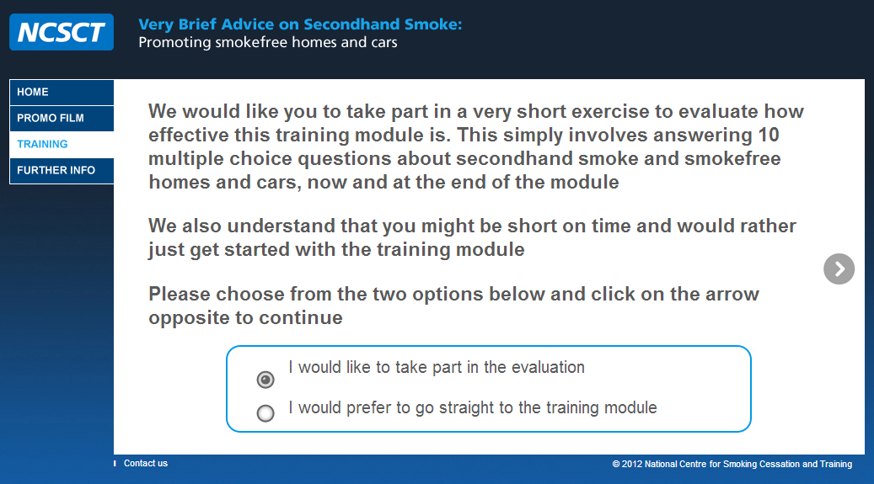
Evaluation
Pre-training
Demographic information
10 knowledge based MCQs
3 confidence questions
Post-training
10 knowledge based MCQs
3 confidence questions
3 month follow up
10 knowledge based MCQs
3 confidence questions
1 practice change question
Views on taking part

Slide 10
Evaluation sample characteristics (n=178) |  | % (n)
Sex | Female | 84 (149)
 | Male | 16 (29)
Age | < 29 years | 11 (20)
 | 30-39 years | 17 (30)
 | 40-49 years | 34 (60)
 | > 50 years | 38 (68)
Profession | GP/Hospital doctor | 2 (3)
 | Nurse, midwife, health visitor | 15 (27)
 | Other | 13 (23)
 | Other HCP | 27 (49)
 | Pharmacist | 6 (11)
 | Stop smoking practitioner | 37 (65)
Region | East of England | 8 (14)
 | London | 5 (8)
 | Midlands, Yorkshire & Humber | 31 (56)
 | North | 18 (32)
 | Other | 5 (9)
 | Scotland & Wales | 4 (7)
 | South | 29 (52)

Slide 11
Knowledge
p<0.000ª
p=0.001^{b}
ªpost vs. pre; ^{b}follow up vs. pre

Slide 12
Confidence
Confidence to raise the issue of SHS
Confidence to offer practical support
Confidence to raise the issue of SFH/C
p<0.000ª
p<0.000ª
p<0.000ª
p<0.000^{b}
P=0.002^{b}
P<0.000^{b}
ªpost vs. pre; ^{b}follow up vs. pre

Slide 13
Influence on practice at 3 months
84% reported that completing the training had led to positive changes in their practice
“It's not about judging people, telling them it's wrong it's all about advice and support, giving people ideas about making the right choice for them and their families”
“I used to "tiptoe" around the topic [SHS]. Now, I speak frankly and directly about this topic, including risks to the patient and offer advice about how to create a smoke free home/car”
“Fantastic real life people who made the process of raising the issue something that everyone could do. Raising the issue of smoke-free homes without pressure to quit I think is key”
“…the training has been a constant support on how I deliver advice to people, for the first time in a long time I feel I am really making a difference in people’s health and lifestyle”
Jones & McEwen Unpublished data

Slide 14
Conclusions
HCPs (and others) are in a unique position to support smoking families
Participating in the evidence based VBA on SHS training
increases both knowledge and confidence – which is maintained over time
leads to self-reported positive changes in practice
VBA for SHS is an effective intervention to support parents to make changes to protect their chiildren

Slide 15
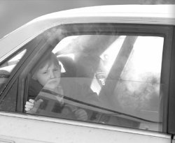
Smoking in cars

Slide 16
Background
After homes, cars most significant source of exposure
SHS particulate level (PM_{2.5}) can be much greater in cars than other spaces
Prevalence of exposure
15% of UK adult smokers report smoking in cars when travelling with children
47% of UK young people report being exposed to smoking in cars
Attitudes to smoking in cars laws
81% of UK adults (including 62% of daily smokers) and 84% of UK young people support a ban on smoking in cars carrying children
Belanger et al. (2008); Kabir et al. (2009); YouGov (2013); Jones et al. (2014)
Notes:
As you are aware, after homes, cars are potentially the second most significant source of SHS exposure for non-smokers, particularly children.
Because of the confined space, SHS particulate matter or PM2.5 can be significantly higher in cars than in other spaces such as homes. One study showed that PM2.5 in a stationary car was 23 times higher than in a home
We often hear about the number of children who are exposed to SHS at home, but we hear less about how many children are exposed to smoking in car, mainly because it’s potentially harder to measure
In data from 2008, 15% of UK adult smokers reported that they smoked in cars when children were passengers
In a study that Linda and I conducted of young person’s exposure to SHS in cars, 47% reported that they were exposed, with 17% reporting that they were exposed once a week or more
There have been a number of studies that have explored attitudes to smoking in cars and there is significant public support for the implementation of smoking bans in cars carry children for both adults and adolescents and for smokers

Slide 17
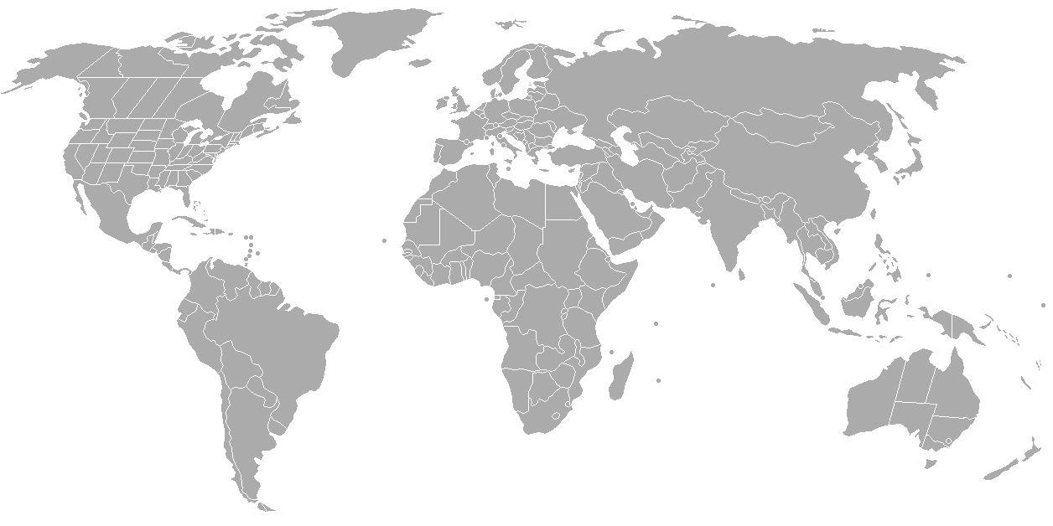
6 of 50 American states & Puerto Rico
Hawaii, Indiana, New Jersey & New York have cities or counties with a ban but not the whole state (since 2006)
10 of 13 Canadian provinces/territories (since 2008)
7 of 8 Australian states/territories (since 2007)
5 countries (since 2009)
Yukon 08
Alberta
Saskatchewan 10
British Columbia 09
Manitoba 10
New Brunswick 10
Ontario 09
Labrador & Newfoundland 11
Oregon 14
Maine 08
PEI 09
Utah 13
Nova Scotia 08
California
08
Arkansas 06
Cyprus 10
Louisiana 06
Bahrain 09
UAE 10
Puerto Rico 07
Mauritius 09
Western Australia 10
Queensland 10
South Africa 09
South Australia 07
NSW 09
Victoria 09
ACT 12
Tasmania 08
Globally, 33 jurisdictions have car smoking laws
Cunningham et al. (2014); McNeill et al. (2013); Sendzik et al. unpublished data

Slide 18
Global mapping review of smoking in cars laws
26 stakeholders interviewed in 2012 from 22 jurisdictions with legislation and 4 with plans to implement legislation
“Do it as quickly as possible. Make sure that police are aware of the infringement and that the public understand why there is a need for the law."
“Get on with it. The evidence is there. The support is there. Do not worry about the opposition. It is very muted and you will be well rewarded. Also it's another step in the right direction of a comprehensive tobacco control strategy"
“…the police can’t stop every vehicle to see if someone is smoking in a car with children. The law has to be self-enforced and then supported by legal action through the police”
McNeill et al. (2013); Sendzik et al. unpublished data
Notes:
As part of this mapping review, we also conducted semi-structured interviews with 26 stakeholders from 22 different jurisdictions
Overall, the stakeholders reported that it was relatively easy to implement laws, especially if it is framed as a way to protect children from harm
In line with data from the UK that I showed earlier, stakeholders reported that the public are in support of legislation and that there is limited opposition
They did however highlight that there is a clear need for champions and policymakers to help move plans forward and that given that the police cannot stop every vehicle and so it needs to be self-enforced supported by legal action where necessary

Slide 19
Smoke-free cars in the UK?
Northern Ireland
Health minister announced in 2013 that they would consult – no consultation as yet
Scotland
Private members bill due to be heard in the next parliamentary session after the referendum
Wales
Monitoring the issue - may legislate but no immediate plans

Slide 20
England
29 Jan 14: amendment to Children & Families Bill passed in House of Lords
Grant Government power to introduce legislation
10 Feb 14: MP free vote. Voted in favour (376 to 107) of the amendment
Empowers, but does not compel, ministers to make it a criminal offence
Reports that legislation introduced in 2015; primary offence with £60 fine
Notes:
There has been significantly more progress towards legislation in England.
In January an amendment to the Children & Families was passed – which granted the Government power to introduce legislation
In February, MPs voted in favour the amendment – which empowers ministers smoking in cars carrying children a criminal offence
Whilst it’s not been confirmed, there are reports that the legislation will be introduced in 2015 and will be a primary offence with a £60 fine

Slide 21
Conclusions
Car smoking laws have the potential to protect children from SHS exposure
Currently 33 jurisdictions with legislation to protect non-smokers (32 of 33 children only)
Evidence to suggest that legislation is easy to implement, faces limited resistance and is a requisite of any comprehensive smoke-free strategy
England likely to legislate in the near future with the hope that other UK countries will follow

Slide 22
Summary
Notes:
To summarise – I’ve talked about two rather different interventions today. Whilst different, both of them have the overall aim of protecting children from the harms of SHS exposure.
Children’s exposure to SHS in both the home and in the car is still an ongoing and significant public health concern, but working together to intervene and hopefully the introduction of legislation to ban smoking in cars carrying children, in England at least, we can make a difference to the lives of children who live with smokers.

Slide 23
Acknowledgements & Funding
Funding Sources
Nottingham HCP Study:
This talk summarises independent research funded by the National Institute for Health Research (NIHR) under its Programme Grants for Applied Research Programme (RP-PG-0608-10020). The views expressed are those of the author and not necessarily those of the NHS, the NIHR or the Department of Health.
NCSCT Training Module:
The training module was developed as part of the work of the National Centre for Smoking Cessation and Training, which was funded by the Department of Health (DOHT336/BSS/M award number 49945).
Smoking in Cars Mapping Review:
This review was funded by a Department of Health Policy Research Programme grant (034/0038).
YTPS Study:
This study was supported by Cancer Research UK (C312/A8721).
Nottingham SFH Team
New Leaf Nottingham City
NCSCT team
Exchange supplies
Ann McNeill
Amanda Farley
Linda Bauld
Andy McEwen
Jen Potts

