Slide 1
Tobacco control and the new structures for public health Professor Kevin Fenton Director of Health & Wellbeing Email: kevin.fenton@phe.gov.uk Twitter: @ProfKevinFenton

Slide 2
Content
PHE and the new public health landscape
PHE Priorities for 2013/14
Health and Wellbeing Priorities
PHE Tobacco Control and Smoking Cessation Activities
2
Working together for the public’s health

Slide 3
The New Public Health System: an integrated whole system approach
Government
DH responsible to parliament, with clear line of sight through system
Cross-government senior officials group to improve health outcomes and use Cabinet Committee structure as required
CMO to continue to provide independent advice to Government
Local authorities
New public health functions integrated into their wider role, helping to tackle the wider social and economic determinants of health.
Leading for improving health and coordinating locally for protecting health
Promoting population health and wellbeing – role of Directors of Public Health
Public Health England
New, integrated national body
Strengthened health protection systems
Supporting the whole system through expertise, evidence and intelligence
NHS
Delivering health care and tackling inequalities
Making every contact count
Specific public health interventions, such as cancer screening
Notes:
Kathryn
There is a role for all of us in this picture.
In the centre there is more reason for us to collaborate than ever before, with squeezed budgets and an increasing evidence base on the intertwined nature of all our work.
For local Authorities having new public health functions integrated into their wider role provides an ideal opportunity to holistically tackle wider social and economic determinants of health.
Public Health England will provide the link between these two levels of working.

Slide 4
Our priorities for 2013/14
Sets out Public Health England’s priorities and actions for the first year of our existence
Five outcome-focused priorities – what we want to achieve
Two supporting priorities – how we will achieve it
27 key actions to take now
The start of the conversation – a three-year corporate plan will follow
4
Working together for the public’s health

Slide 5
Outcome-focused priorities
Helping people to live longer and more healthy lives by reducing preventable deaths and the burden of ill health associated with smoking, high blood pressure, obesity, poor diet, poor mental health, insufficient exercise, and alcohol
Reducing the burden of disease and disability in life by focusing on preventing and recovering from the conditions with the greatest impact, including dementia, anxiety, depression and drug dependency
Protecting the country from infectious diseases and environmental hazards, including the growing problem of infections that resist treatment with antibiotics
Supporting families to give children and young people the best start in life, through working with health visiting and school nursing, family nurse partnerships and the Troubled Families programme
Improving health in the workplace by encouraging employers to support their staff, and those moving into and out of the workforce, to lead healthier lives
5
Working together for the public’s health

Slide 6
Supporting priorities
Promoting the development of place-based public health systems
Developing our own capacity and capability to provide professional, scientific and delivery expertise to our partners
6
Working together for the public’s health

Slide 7
Local Authorities
Local Authorities, with detailed understanding of their communities and circumstances are the natural leaders for public health in their areas. Public Health England will support them with knowledge and expertise to help them deliver on their responsibilities
PHE is structured into four regions and fifteen centres spread across the country. The centres are key to the interaction with local authorities

Slide 8
Sources of public health advice in the ‘Place-based’ approach to local public health
3rd sector providers
NHS & IS Providers
People and communities
Health and wellbeing boards
PHE
centre
Local government
CCGs & their support
NHSCB
area team
Public health advice
Commissioner of public health services

Slide 9
Partnerships will be key
Public Health England cannot succeed by itself. Our partnerships with local authorities, the NHS and the third sector are what will allow us to achieve the outcomes we want.
Our partners provide broader avenues by which the public interact with the health system and may be advocates for public health. PHE will work with and support our partners to ensure the best outcomes.

Slide 10
The PHE Health and Wellbeing Directorate

Slide 11
Health and Wellbeing Directorate
Our work will save lives, promote wellbeing and create environments that enable individuals, families, and communities be informed, empowered, healthier and more productive.

Slide 12
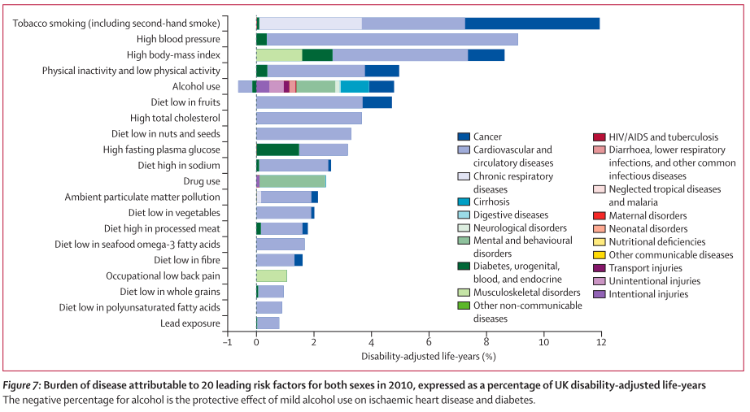
Reducing Avoidable Deaths

Slide 13
Health Impact Priorities Health and Wellbeing Directorate
Well being and Mental Health
Mental disorder accounts for largest burden (23%) of diseases in England and affects >1 in 4 of the population at any time
Diet, Obesity, and Physical Exercise
Health and Wellbeing Directorate
Health Impact Priorities
All major causes of CVD and cancer. Obesity increases risk of type II diabetes (5-13 times), hypertension (2-3 times) and colorectal cancer (3 times) in men.
Tobacco Control and Smoking Cessation
Accounts for 20% of new cases of cancer (23%M and16%F)
Tobacco causes nearly 1 in 5 deaths in England annually
For each death, 20 more suffer tobacco-related illnesses
Alcohol Moderation and Drug Recovery
Much of the cost of drug and alcohol misuse occurs to the criminal justice system. The main costs to society from drug an alcohol is from related crime.
While supporting and ensuring progress against the PHOF, the Directorate will provide enhanced focus on the major drivers of mortality and morbidity in England where further gains may be made by scaling known, effective strategies
HIV, Sexual Reproductive health
By the end of 2012 likely more than 100,000 PLWHA in the UK. Late diagnosis a major problem with 50% diagnosed with CD4<350

Slide 14
Taking action on tobacco control and smoking cessation

Slide 15
Actions 2013/14
Reducing preventable deaths
Support people to live healthier lives by implementing NHS Healthchecks
Accelerate efforts to promote tobacco control and reduce the prevalence of smoking
Report on premature mortality and the Public Health Outcomes Framework
Enable improved integration of care, to support local innovations to find alternatives to hospital-based care
15
Working together for the public’s health
Notes:
Support people to live healthier lives by implementing NHS Healthchecks to 15 million eligible people. We will support the roll-out of the Healthcheck programme by local authorities, assuring full implementation across the country.
Accelerate efforts to promote tobacco control and reduce the prevalence of smoking. We will identify, support and champion national and local efforts to accelerate smoking cessation, promoting the use and implementation of evidence based-interventions, and addressing variations in smoking.
Report on premature mortality and the Public Health Outcomes Framework. We will introduce a web-based reporting system to report transparently on premature mortality and the other indicators in Public Health Outcomes Framework for each local authority, to inform local accountability for performance and improvement.
Enable improved integration of care, to support local innovations to find alternatives to hospital-based care, especially for our frail older population. We will work with national partners to identify and share best practice on the potential contribution of prevention and early intervention to person-centred care, and work with local areas pioneering innovative approaches to integrating health, social care and healthcare public health to identify and tackle barriers to progress.

Slide 16
Health and Wellbeing Directorate Tobacco Control and Smoking Cessation objectives
Increase healthy life expectancy by reducing smoking prevalence and its consequences (includes social marketing campaigns)
Support and facilitate delivery of policy and governmental aspects of the Tobacco Strategy
Sustain and support infrastructure for tobacco control and smoking cessation, collaborating with key players in TC and SS
Increase system-wide emphasis on TC and SS in specific vulnerable and high impact groups
Support development of information and intelligence for TC and SS, including appropriate guidance and advice on practice

Slide 17
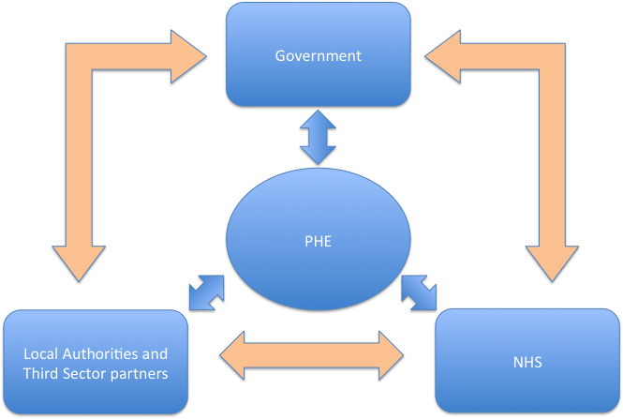

Slide 18
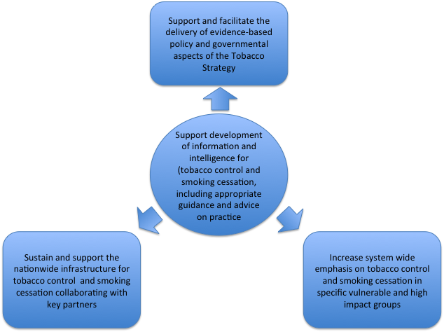

Slide 19
Health and Wellbeing Directorate Tobacco Control and Smoking Cessation Strategies
Stopping the promotion of tobacco
Making tobacco less affordable (reduce availability and supply)
Effective regulation of tobacco products
Helping tobacco users to quit / preventing new users starting
Reducing exposure to second-hand smoke
Effective communications for tobacco control
Information and intelligence
Lobbying and persuasion
Networks, co-ordination, training and support

Slide 20
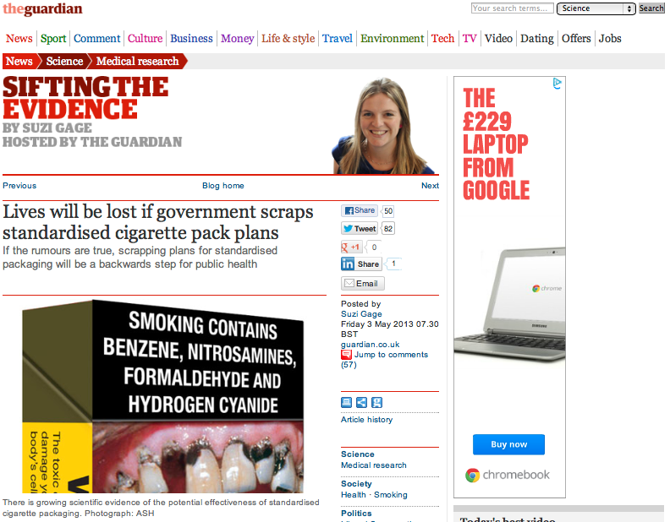
Stopping promotion of tobacco

Slide 21
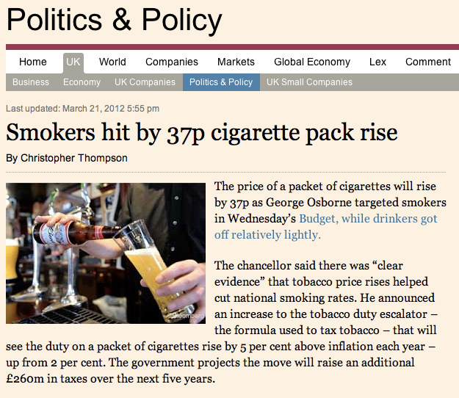
Making tobacco less affordable

Slide 22
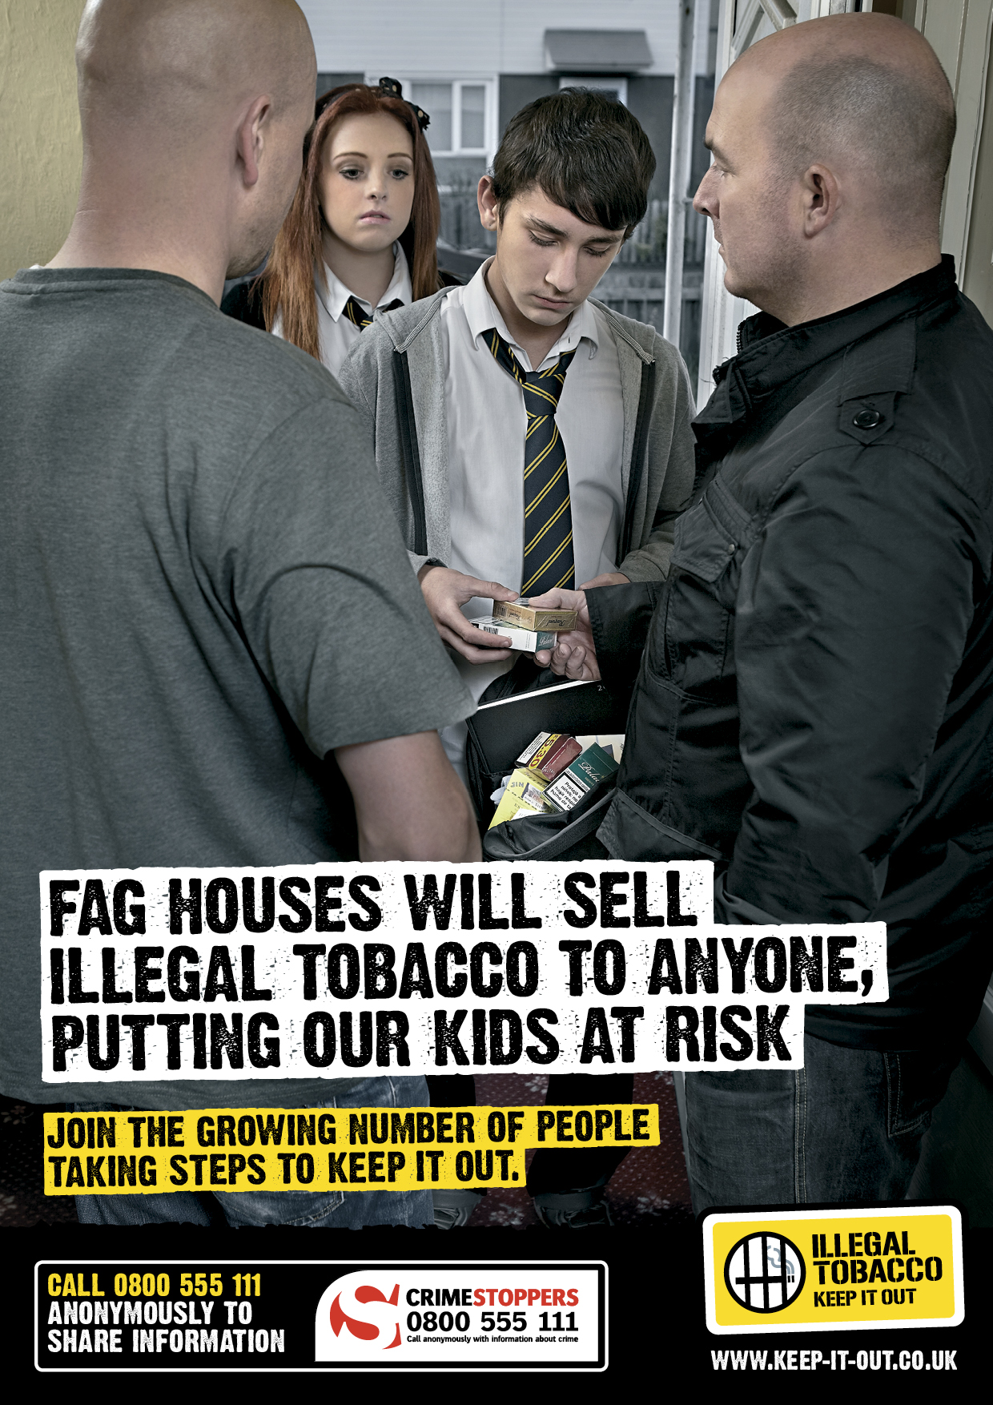
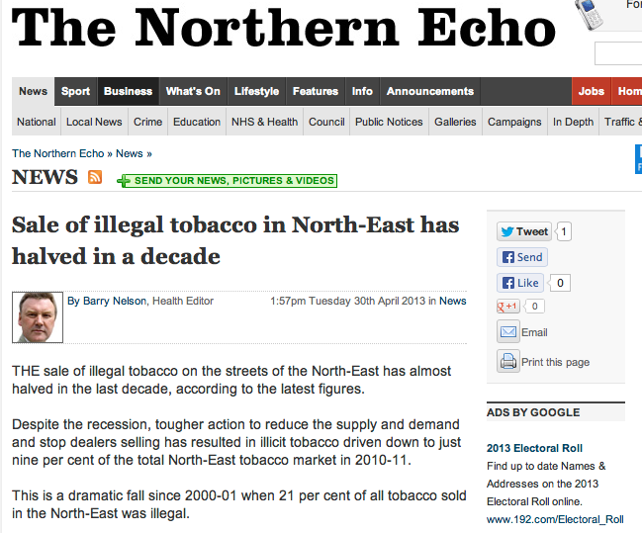
Effective regulation

Slide 23
Helping tobacco users to quit
Maintain and expand Stop Smoking Services
Clarify future identity, training, standards and review – ‘kite marking’?
Interventions to reduce smoking, working with the NHS:
- reduce smoking in pregnancy
- among people with mental health problems
- among people in contact with the justice system
- initiating quitting from or in secondary care
Supporting optimised performance
Positioning of harm-reduction

Slide 24
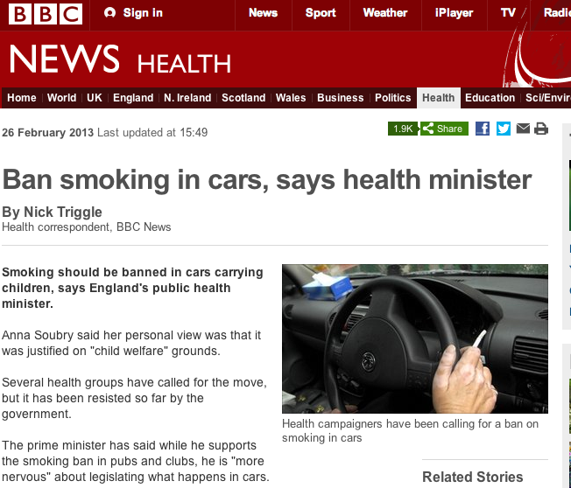
Reducing secondary smoking

Slide 25
Reducing secondary smoking
Scotland 2012: “Reductions were observed in the risk of preterm delivery and small for gestational age 3 months prior to the introduction of legislation, although the former reversed partially following the legislation.”
Ireland 2012: “A significant reduction in small-for-gestational birth rates both immediately and sustained over the post-ban period, reinforces the mounting evidence of the positive health effect of a successful comprehensive smoke-free legislation in a vulnerable population group as pregnant women.”
Belgium 2013: “We found reductions in the risk of preterm birth after the introduction of each phase of the smoking ban. No decreasing trend was evident in the years or months before the bans…Our study shows a consistent pattern of reduction in the risk of preterm delivery with successive population interventions to restrict smoking.”

Slide 26
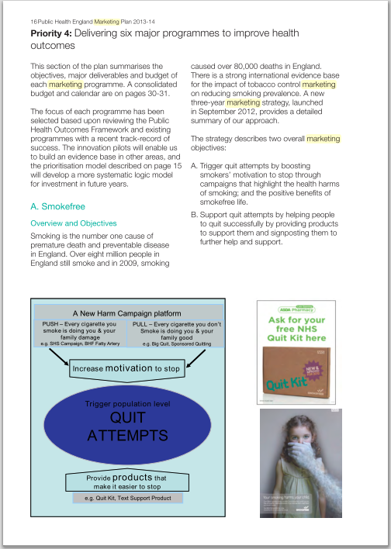
Effective communications

Slide 27
Information and intelligence
To make the new system work as it is intended, we need to bring information on smoking behaviours to the level of communities, so that they can own and act on the issue.
Prevalence and quit figures are always going to be problematic at this level.
Tobacco sales data would allow us to measure by proxy the cigarette consumption of small areas on an almost real-time basis – we will explore means to access these, including the possibility of lobbying to require Big Tobacco to supply their data.

Slide 28
Sir Richard Doll Epidemiologist 1912 - 2005
Advocacy and persuasion
[In 2002] … on the BBC radio programme Desert Island Discs, Doll said he had formulated a strategy towards health education:
"Find out what the tobacco industry supports and don't do it, and find out what they object to and do it."
The Guardian May 2005

Slide 29
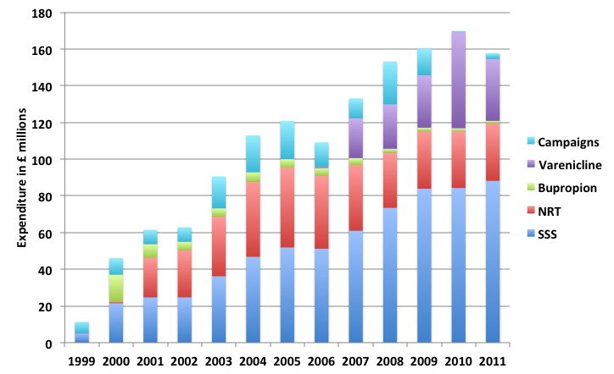
Preventive spends are actually shown on this graph, but they are so small in comparison to health care spending that they are almost invisible.
For a risk factor that is responsible for around a fifth of all deaths and a ninth of all disability-adjusted life years, does this seem appropriate?
Advocacy and persuasion
ASH Briefing: UK Tobacco Control Policy and Expenditure Updated October 2012

Slide 30
Conclusions
Critical progress has been made in reducing smoking prevalence, raising awareness, and ensuring range of effective clinical and behavioral interventions available
Evolving patterns of tobacco usage, illicit sales, novel products, packaging and marketing present new challenges
New public health system provides opportunities for new partnerships, approaches, and resources
Now need to engage, mobilize and focus across system for impact

Slide 31
Tobacco control and the new structures for public health Professor Kevin Fenton Director of Health & Wellbeing Email: kevin.fenton@phe.gov.uk Twitter: @ProfKevinFenton

