Slide 1
Short-term efficacy of nicotine replacement therapy (NRT) for smoking cessation among adolescents and the role of compliance
Charlotte Scherphof*
Regina van den Eijnden*
Wilma Vollebergh*
Rutger Engels^
* Utrecht University, The Netherlands
^ Radboud University Nijmegen, The Netherlands

Slide 2
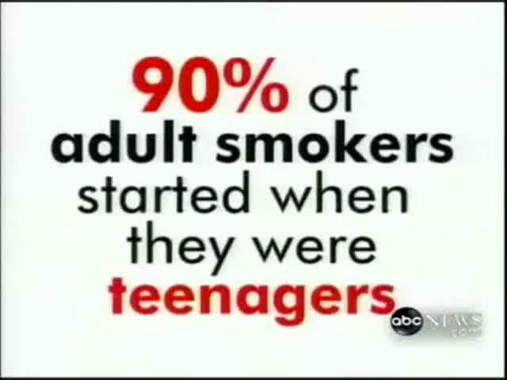

Slide 3
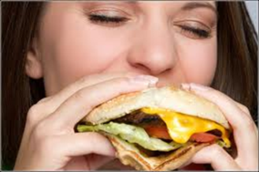


Introduction
Nicotine dependence symptoms:
  60.9% of adolescents who ever smoked cigarettes daily had tried to quit smoking, but…
    only 12.2% were successful.
Nicotine Replacement Therapy (NRT) as smoking cessation intervention

Slide 4
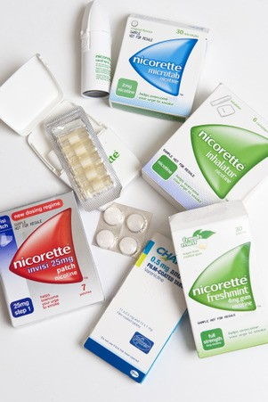
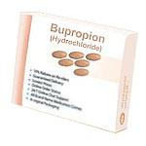
Introduction
Meta-analysis (2011):
  6 RCTs
Review (2012):
  9 RCTs, 1 lab-based study, 3 open-label studies
Results:
  Short-term (end-of-treatment): /
  Mid-term (3-6 months):

Slide 5
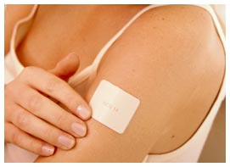
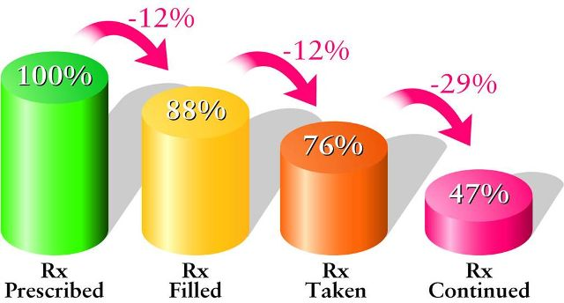
Introduction
Flaws
  Small sample sizes (9 of 11: N < 135)
  High drop-out
  Low compliance (8-67%)
    no moderation effects
condition smoking cessation
compliance

Slide 6
Our study –
Randomized Controlled Trial
(1) efficacy of NRT (nicotine patch) on short-term smoking cessation?
(2) is the effect of NRT on smoking cessation moderated by patch use compliance?
  2a) can different trajectories of compliance be distinguished?
  2b) which factors predict different trajectories?
(3) are there any (serious) adverse effects?

Slide 7

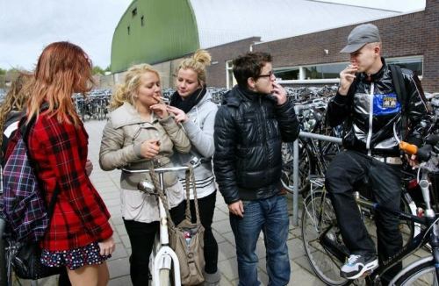

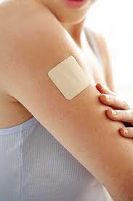

Method
€ 90
Adolescents: N = 257,
mean age 16.7 years,
53% female
Information meeting
6/9 week treatment
6 online questionnaires
Age 12 -18 years
No major physical health problems
≥ 7 cigarettes per day
Parents aware of kids smoking behaviour
Motivated to quit smoking

Slide 8
Outcome measures
Smoking cessation (intent-to-treat)
  abstinence after two weeks / end-of-treatment abstinence (prolonged abstinence)
Compliance
  number of days participants used the patches
Adverse events
  complaints concerning health / patch use
Treatment period
Week 1
Week 2
Week 3-6
T1-T3
T4
T5
T6
Abstinence after 2 weeks
End-of-treatment abstinence

Slide 9
Results – Main effect + Moderation
Abstinence after two weeks
End-of-treatment abstinence
OR = 1.80*/2.02*
condition
abstinence after 2 weeks
OR = 1.12/1.12
compliance
OR = 0.83/0.79
condition
abstinence at end of treatment
OR = 1.07†/1.09*
compliance

Slide 10
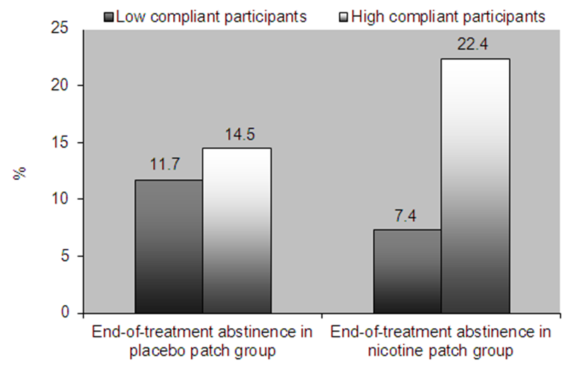
Results – Percentages quitters
 | Abstinence after 2 weeks | End-of-treatment abstinence
Placebo patch group | 21.3% | 13.1%
Nicotine patch group | 31.9% | 14.8%
7
9
5
15

Slide 11
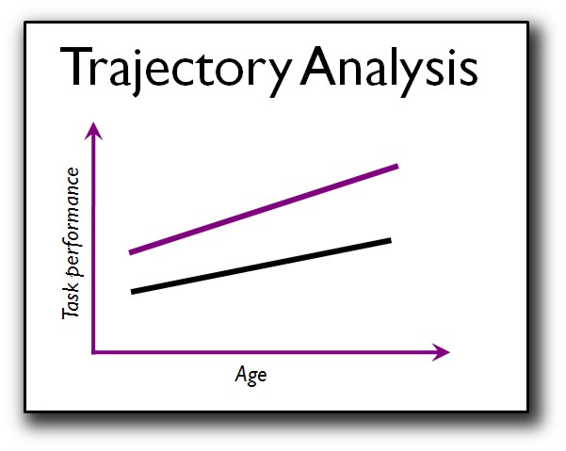

Compliance
Compliance
Predictors
Time

Slide 12
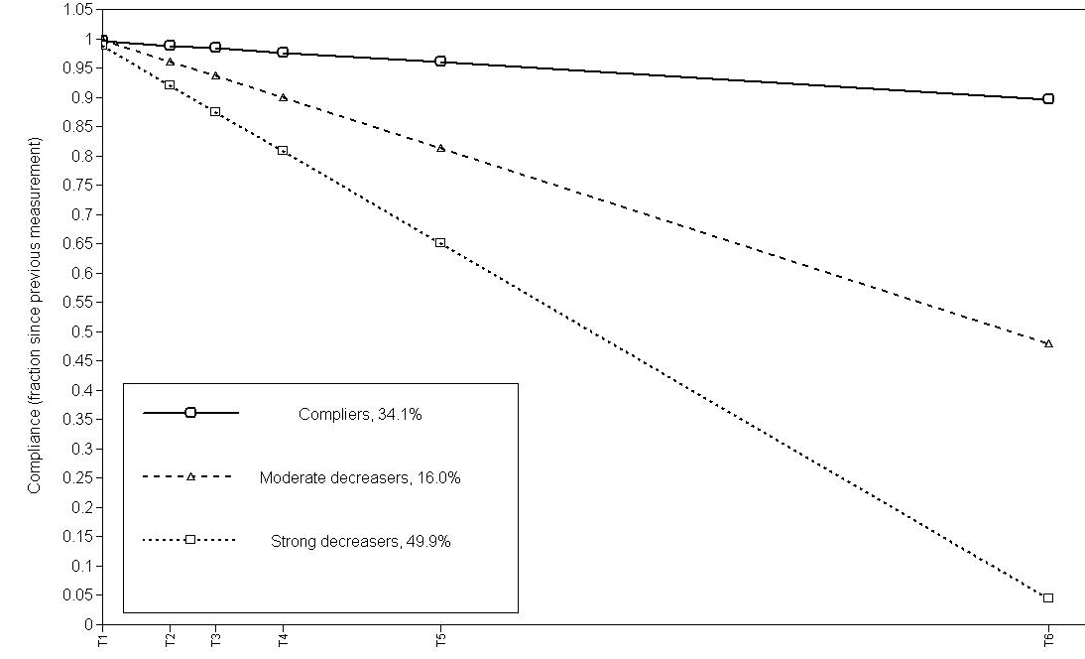
Results – Compliance trajectories (LCGA)
Predictors
Age
Gender
Education
#CigPerDay
Previous quit att.
Impulsivity
Conscientiousness
Openness
Extraversion
Neuroticsm
Agreeableness
Condition
23%
10%
Compliers: 34%
Moderate decreasers: 16%
Strong decreasers: 50%
9%

Slide 13

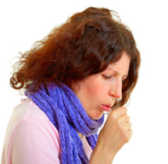



Results – adverse events
Most reported adverse events
In general more complaints in nicotine patch group
(but scores max 2 out of 3)

Slide 14

Conclusion
(1) Nicotine patches enhance abstinence rates after two weeks.
(2) Nicotine patches enhance abstinence rates at end-of-treatment, but only among high-compliant adolescents.
(2a,b) Higher number of previous quit attempts,
higher level of conscientiousness and
lower levels of extraversion were associated
with higher levels of compliance.
(3) No serious adverse events.
Bgjsbel

Slide 15

Discussion
Decline in compliance rates and
abstinence rates from 2 weeks
to end-of-treatment
  Clinical relevance?
Comparison with previous studies (our study: 14.8% abstinence at end-treatment)
  18% (PA, 2-week grace period, 12 weeks of treatment)
  28% (7-day PP, 8 weeks of treatment)
  28% (7-day PP, 10 weeks of treatment)
Time-varying predictors for compliance trajectories

Slide 16
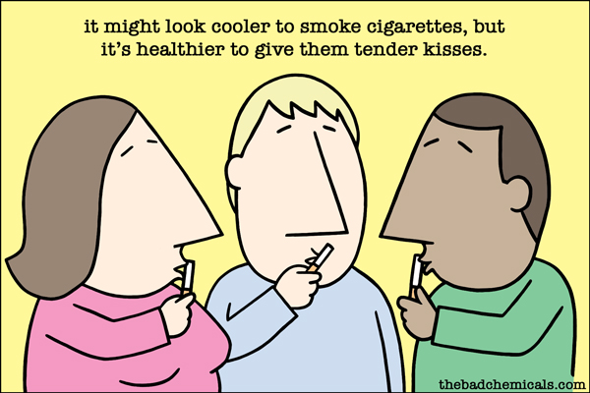
Implications
So far, no convincing evidence of efficacy NRT for adolescents
Interventions to enhance compliance
Influence of (smoking) peers

Slide 17
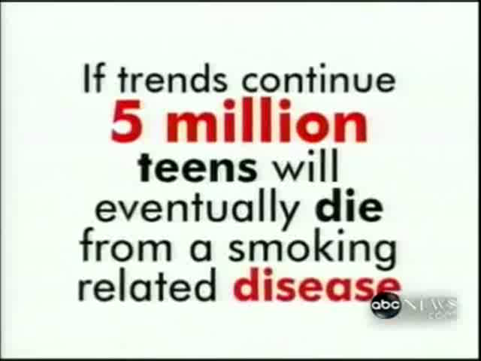

Slide 18
  “Interventions aimed at quitting smoking among adolescents are a waste of time (and money)”

Slide 19


Thank you for your attention
Charlotte Scherphof
c.s.scherphof@uu.nl

Slide 20
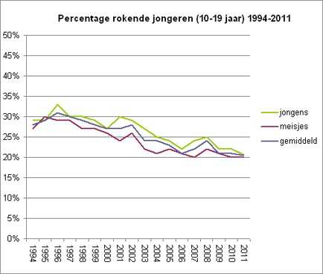
Introduction
Percentage smoking adolescents (10-19 years) 1994-2011
boys
girls mean

Slide 21
Results - Short-term effects
Condition
Smoking cessation
Compliance
Condition
Smoking cessation
Compliance

